Slide 1
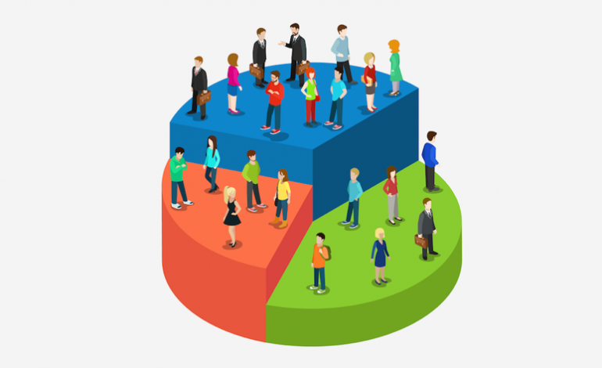
Customer Segmentation Analysis using Power BI
Team 1: Rakshith S, Anvesh, Atul Sharma, Ashwin Balaji, Pranav, Rahul Singh
A Data-Driven Approach Using Power BI

Slide 2
Introduction
In today’s competitive retail landscape, understanding customer behavior and preferences is key to driving business growth. This project, Customer Segmentation Analysis Using Power BI, leverages a rich dataset of shopping trends to uncover actionable insights. By analyzing purchasing patterns, demographic details, and preferences, this analysis aims to help businesses make informed decisions for personalized marketing strategies, optimized inventory management, and enhanced customer satisfaction.
Objective
Understanding product and category preferences.
Analyzing payment and shipping trends.
Gaining insights into seasonal trends and frequency of purchases.
Identifying key customer segments.
Developing strategies to maximize revenue and improve customer retention.

Slide 3
Dataset Overview
Overview of the Dataset:
Data Source: Kaggle
Dataset Name: Shopping Trends
Key Fields:
Customer Demographics: Customer ID, Age, Gender, Location
Purchase Details: Item Purchased, Category, Purchase Amount (USD)
Preferences: Payment Method, Shipping Type, Frequency of Purchases
Feedback: Review Rating

Slide 4
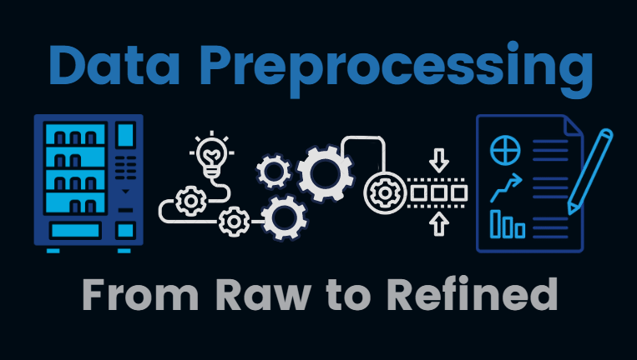
Data Preprocessing
Standardized Data Types: Ensured consistency across all columns.
Introduced Age Groups: Categorized customers into distinct age brackets for better segmentation.
Added Category Preferences: Highlighted the most frequently purchased categories for each customer.
Created Purchase Categories: Derived new insights by grouping similar purchase behaviors

Slide 5
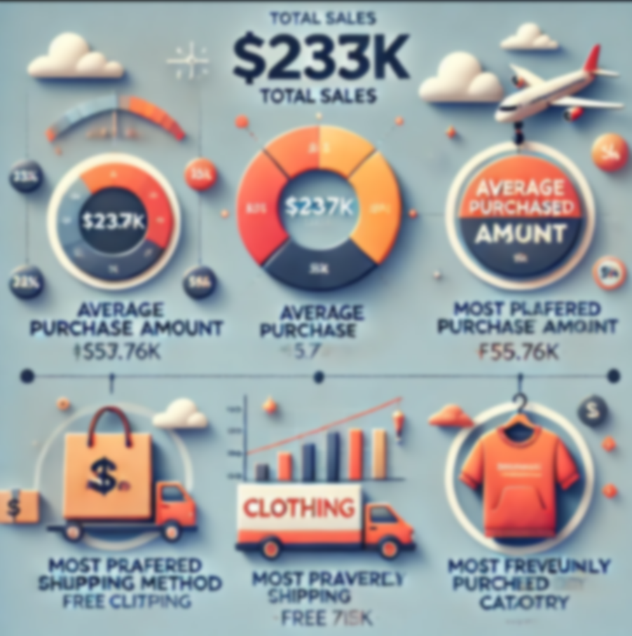
Key Metrics
Total Sales: $233K, showcasing the overall business revenue.
Average Purchase Amount: $59.76K, indicating strong customer spending behavior.
Most Preferred Shipping Method: Free shipping, driving the highest sales volume.
Most Frequently Purchased Category: Clothing, leading in customer preference and purchase frequency.

Slide 6
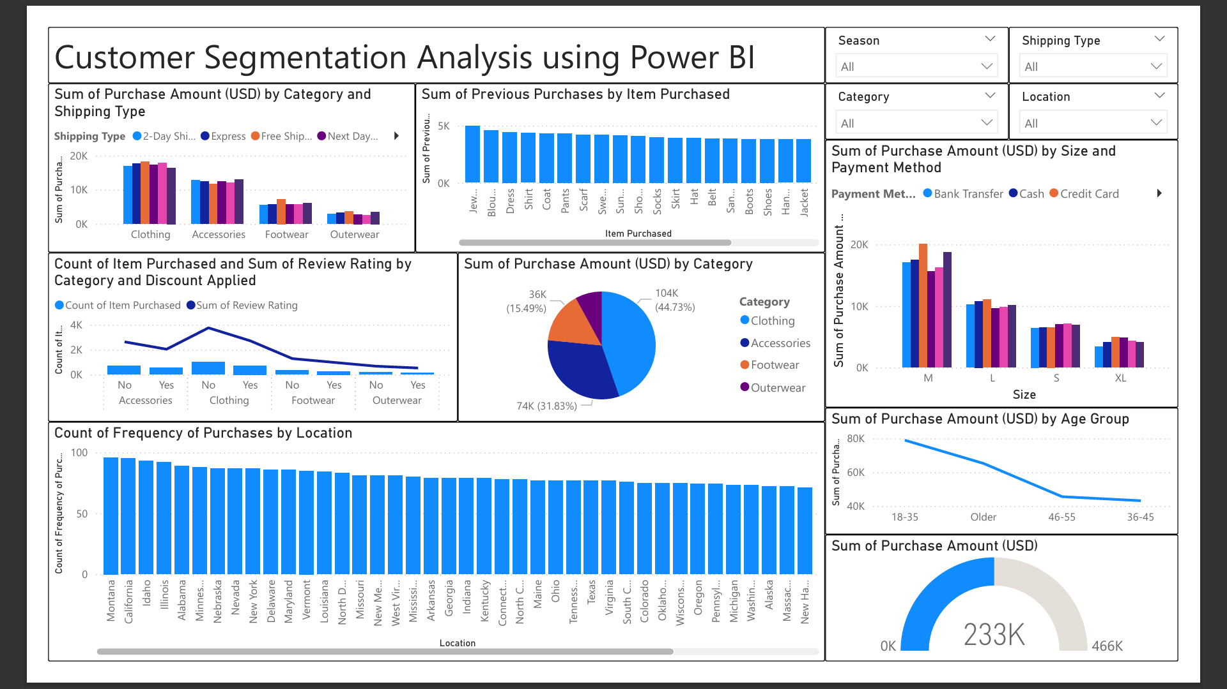
Dashboard Overview
This dashboard provides a comprehensive overview of customer segmentation analysis, focusing on metrics like total purchases, categories, locations, and payment methods. Key visualizations include bar charts, pie charts, a gauge for total sales, and trend lines.

Slide 7
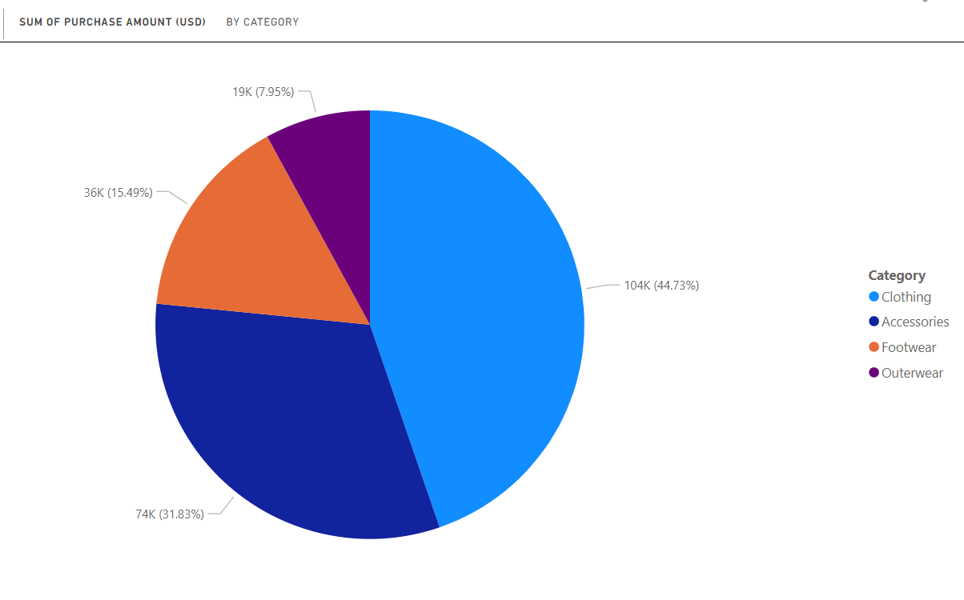
Pie Chart Insights
Largest Category: Clothing, accounting for 44.73% of total purchases.
Smallest Category: Outerwear, with the least share among all categories.

Slide 8
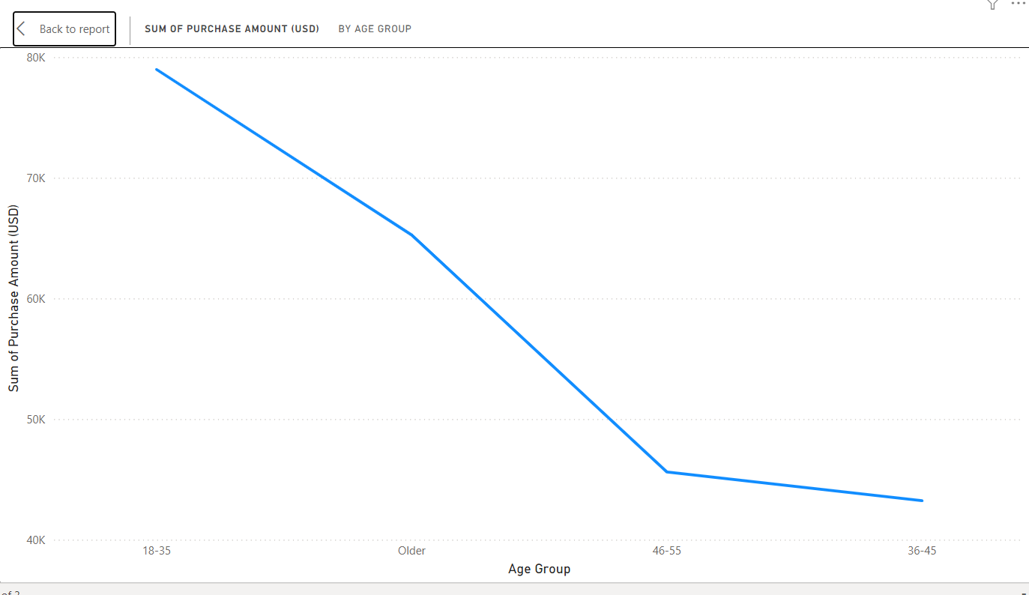
Line Chart
Younger age groups (18–35) contributed significantly to sales.
Sales decrease for older age groups, indicating a younger target demographic.

Slide 9
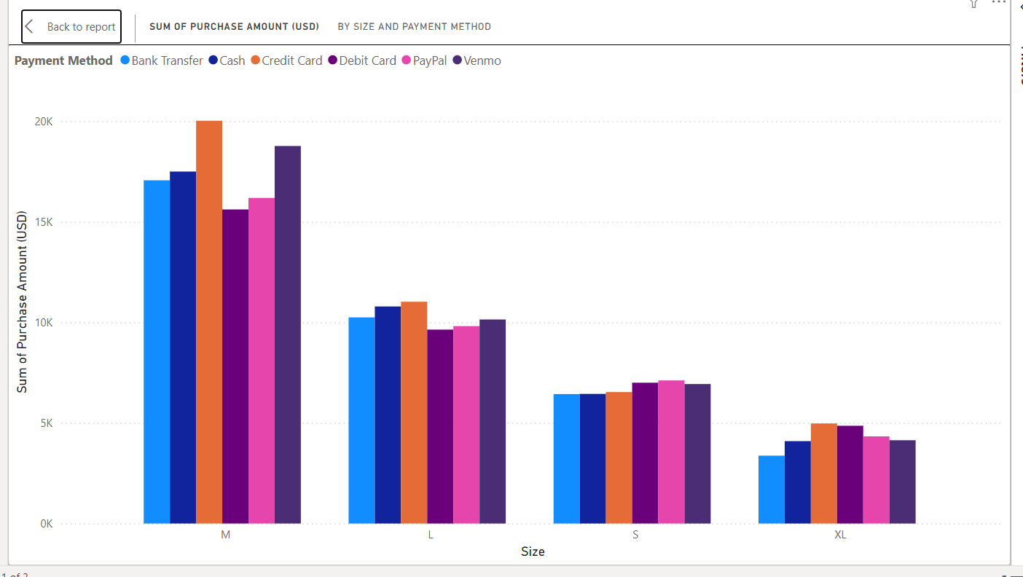
Clustered Column Chart 1
Medium and large sizes are most purchased.
Credit cards and cash are the most preferred payment methods.

Slide 10
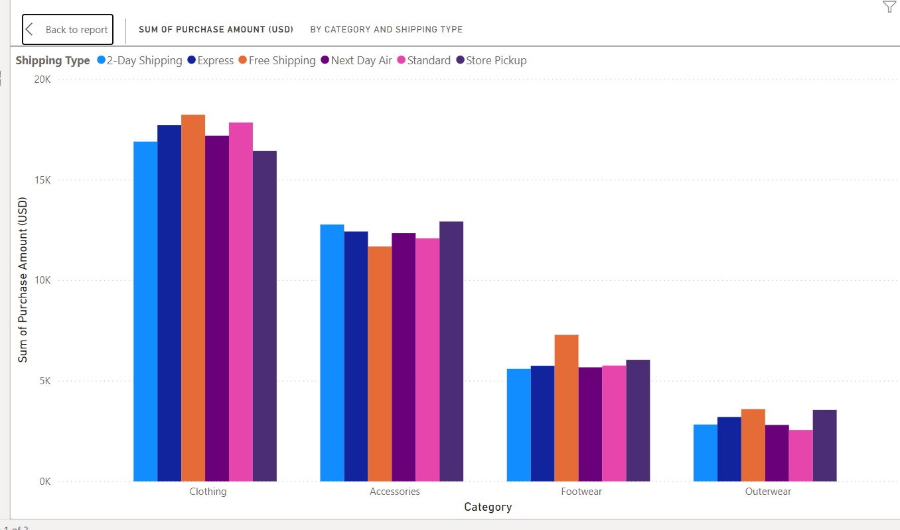
Clustered Column Chart 2
Clothing Dominates: Clothing has the highest purchase amounts across all shipping types, with Free Shipping and Express leading.
Accessories Balanced: Accessories show moderate purchase amounts, evenly distributed across shipping types, with Store Pickup performing well.
Footwear and Outerwear: Footwear has moderate purchases, while Outerwear shows the lowest purchase amounts across all shipping types.
Free Shipping Preferred: Free Shipping is consistently the most preferred method across all categories.

Slide 11
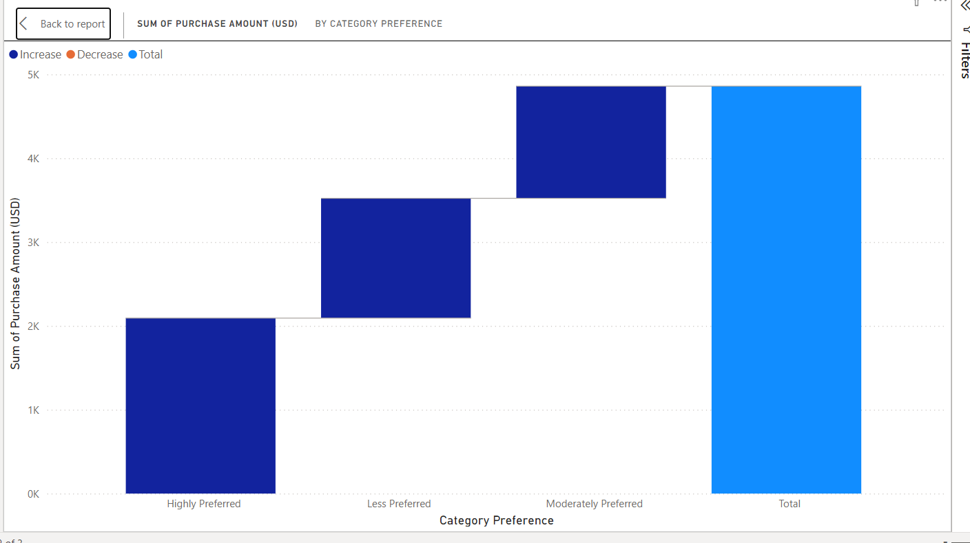
Waterfall Chart
Highly Preferred Categories: These generate the second-highest purchase amounts, showing significant customer inclination toward these categories.
Moderately Preferred Categories: These contribute the least to purchase amounts, indicating a lower interest or priority among customers.
Less Preferred Categories: Despite being less favored, they outperform moderately preferred ones in purchase contributions.
Total Contribution: The cumulative purchase amount highlights that highly preferred categories are key revenue drivers, necessitating focused marketing strategies to maintain and grow this segment.

Slide 12
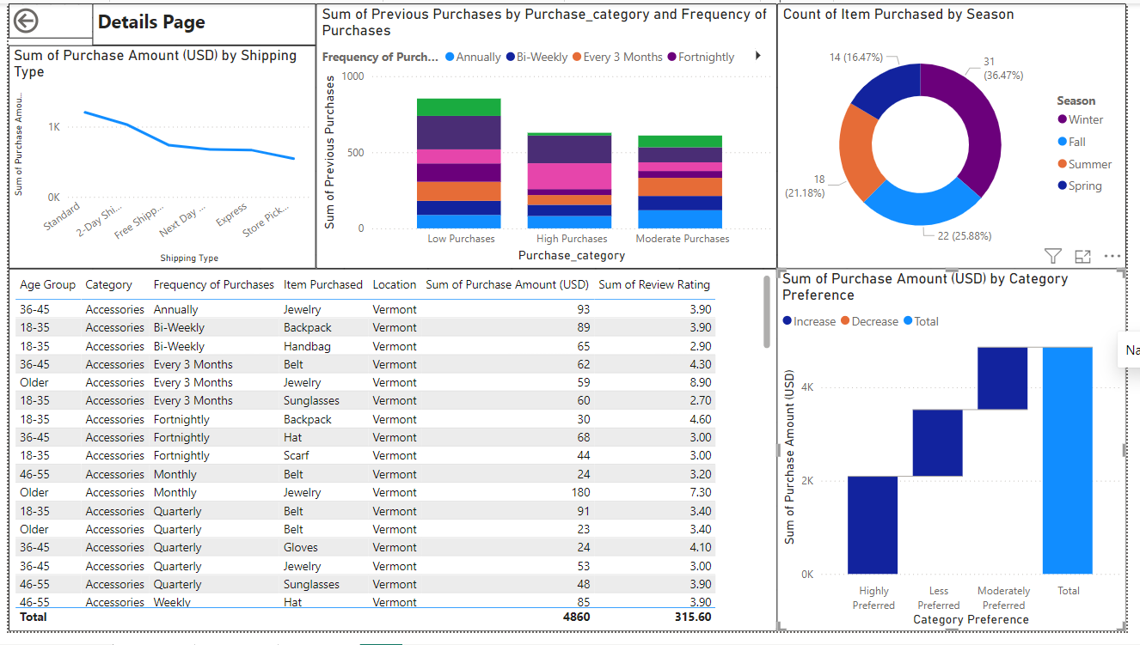
Drill Through Details Page
Focus on Free Shipping: Promote free shipping options to further drive customer purchases.
Target High Revenue Seasons: Align campaigns with the Summer season to leverage peak purchase counts.
Enhance Low Performing Categories: Develop strategies for Moderate Purchase categories to diversify revenue streams.
Leverage Age-Group Insights: Tailor marketing strategies for 18-35 and 36-45 age groups, as they show consistent purchase behavior.

Slide 13
Key Findings
Shipping Preferences: Free Shipping drives the highest revenue, while Expedited and Premium shipping options show lower impact.
Seasonal Demand: Summer accounts for the highest purchases (36.47%), followed by Spring and Winter.
Purchase Frequency: Annual and Bi-Weekly buyers dominate high-purchase categories, indicating loyal customers.
Category Preferences: Highly Preferred Categories contribute the majority of revenue; Less Preferred categories underperform.
Demographic Trends: The 18–45 age group makes the most purchases, especially Accessories, with high satisfaction ratings.
Product Popularity: Accessories such as Jewelry, Backpacks, and Handbags are in high demand.
Customer Ratings: Average review ratings (3.9–4.5) indicate strong customer satisfaction.
Opportunities: Promote Less Preferred categories and expand marketing during high-demand seasons like Summer.

Slide 14
Recommendations
Enhance Free Shipping: Focus on optimizing logistics and costs for Free Shipping as it drives the highest revenue.
Seasonal Promotions: Launch targeted campaigns and discounts during Summer and Spring to capitalize on peak purchasing seasons.
Loyalty Programs: Reward Annual and Bi-Weekly buyers with exclusive deals to retain and encourage high-purchase frequency.
Boost Less Preferred Categories: Offer discounts, bundles, or special promotions to increase interest in underperforming categories.
Target Younger Demographics: Create personalized marketing campaigns for the 18–45 age group, emphasizing Accessories and popular products.
Upsell Accessories: Highlight popular items like Jewelry, Backpacks, and Handbags in promotions to maximize sales.
Improve Ratings: Gather feedback from customers and address areas for improvement to further enhance satisfaction and loyalty.
Expand Shipping Options: Introduce flexible shipping options like same-day delivery to attract customers willing to pay for convenience.
Data-Driven Decisions: Regularly monitor purchasing trends and adapt inventory and marketing strategies accordingly.
Season-Specific Inventory: Stock up on high-demand products during Summer and Spring to meet customer needs efficiently.

Slide 15
Conclusion
Recap:
The analysis reveals key insights into customer spending patterns, popular product categories, and preferred shipping methods.
These findings empower data-driven strategies to drive business growth and enhance customer experience.
Future Scope:
Develop predictive models for accurate sales forecasting.
Integrate customer feedback to refine product offerings and improve satisfaction.

Slide 16
Thank You

